Slide 1
Basic Motivational Interviewing A Conversation About Change
Horizonte Instruction and Training Center
UAACCE
Joshua Bell, Wendy Jack-Alvarado,
Eleanor Chase

Slide 2
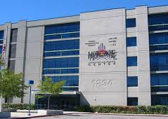
Horizonte Instruction and Training Center
UAACCE 2019

Slide 3
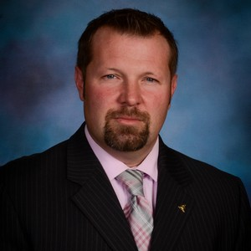
Joshua Bell
Principal, Horizonte Instruction and Training Center
Director of SLCSD Adult Education
Court Registered Mediator
USA Certified Boxing Coach
Trained in Motivational Interviewing through the Motivational Interviewing Network of Trainers (MINT)

Slide 4
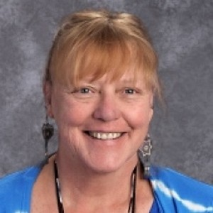
Wendy Jack-Alvarado
Director, Salt lake City School District Youth in Care Program (YIC)
Licensed School Social Worker
Motivational Interviewing On-Site Team
Member
Court Registered Mediator

Slide 5
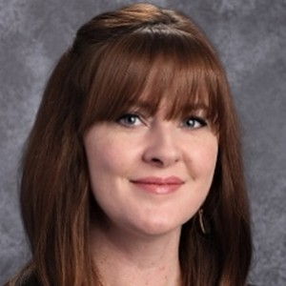
Eleanor Chase
School Counselor
Motivational Interviewing On-Site Team
Member
SAFE UT Coordinator
LGBTQIA+ Staff Coordinator
College/ Career Advisor

Slide 6
Introductions – Elbow Partner
Name
Current Role/Title
What is most challenging about your work?
What do you want to take away from this presentation?

Slide 7
Before we start:
Etiquette and Housekeeping Items
Agenda-
Who we are and what we do
Why Is MI a good fit?
What is MI?
How it works
Next steps
Practitioner Perspective (Eleanor and Wendy)
Questions
Notes:
Respect, Courage, Objectivity, Technology

Slide 8
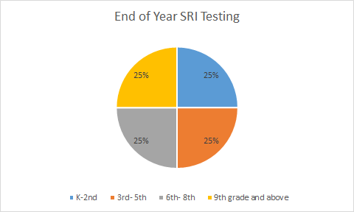
Student Data Analysis- Where we Were
25% of our students were reading above a 9th grade level
However, 75% of our students were reading below a 9th grade level.
Student SRI Data at the end of last school year

Slide 9
Student Impact
Certified Nursing Assistant- Horizonte Criteria for Referrals:
Good Academic Standing in all classes
On pace to graduate by the end of the year
Good Attendance
No behavior issues
30 Students qualified
Certified Nursing Assistant- Salt Lake Community College Criteria for Admission:
6th Grade TABE Reading score
5th Grade TABE Math score
Only 9 of the initial 30 qualified…
In Summary, Certified Nursing Assistant is among the most accessible vocational training programs offered through SLCC, yet, only 30% of our graduating seniors qualified for admissions because they could not demonstrate an ability to read at a 6th grade level or perform math functions at a 5th grade level.

Slide 10
Purpose
“To teach students the basic and executive functioning skills they need to access opportunities and self-advocate for success after graduation.”

Slide 11
Have you had training in Motivational Interviewing? -Elbow Partner-
What is Motivational Interviewing?
Share what you know about MI in two minutes
Then, take turns sharing why you want to know more about it.
Notes:
Helps people explore ambivalence about changing behavior
William Miller and Stephen Rollnick
Directive-guiding toward behavior change AND person-centered-attentive to needs, wishes, expertise, beliefs, experiences of the person in reentry
Extensively researched-effective in supporting adherence to parole/reentry plans, supporting pro-social behavior, supporting substance use recovery

Slide 12
Motivational Interviewing (MI)
MI is a collaborative communication style for strengthening a person’s own motivation and commitment to change.
Notes:
A conversation about change
A spirit
A method

Slide 13
Ways of being with people
Directing Guiding Following

Slide 14
Four Aspects of the “Spirit”
Partnership - collaboration
Acceptance - including accurate empathy, autonomy support, absolute worth and affirmation
Compassion - promoting the welfare of the client
Evocation - “Evoking that which is already there.” not “Installing what is missing.”

Slide 15
Four MI Processes
Engaging: The process of establishing a helpful connection and working relationship
Focusing: The process by which you develop and maintain a specific direction in the conversation about change
Evoking: The process of calling forth from the client, information about change
Planning: The process encompasses developing commitment to change & formulating a concrete plan of action

Slide 16
Sympathy vs Empathy -Know the difference-
Empathy refers to seeking to understand another person’s emotional state and reflecting that feeling
Sympathy does not require this, but is a concern or “feeling sorry” for the troubles of another person

Slide 17
Evocation
“People are usually better persuaded by the reasons which they have themselves discovered than by those which have come into the minds of others.”
- Blaise Pascal

Slide 18
Ambivalence
“People often get stuck, not because they fail to appreciate the down side of their situation, but because they feel at least two ways about it.”
Miller and Rollnick

Slide 19
Ambivalence
The most common place to get stuck
Arguments both for and against already exist within the person
If you’re arguing for change and the person is arguing against it…it’s exactly backward! (Reactance theory)
Notes:
OR the person is saying/doing what he/she thinks will get him/her out of your office the fastest.

Slide 20
Summarizing Ambivalence and the MI Spirit
MI style is guiding/coaching
Ambivalence is normal and people can remain stuck (us too!)
When we use a directing style in the face of ambivalence we bring out the person’s opposite arguments, thus reinforcing the status quo
People are more likely to be persuaded by what they hear themselves say

Slide 21
Basic practice of MI

Slide 22
Basic practice of MI
Don’t try to persuade or fix anything. Don’t offer advice. Instead ask these four questions one at a time, and listen carefully to what the person says:
Why would you want to make this change?
If you did decide to make this change, how might you go about it in order to succeed?
What are the three best reasons for you to do it?
How important would you say it is for you to make this change, on a scale from 0 to 10, where 0 is not at all important, and 10 is extremely important? [Follow-up question: And why are you at _____ rather than a lower number of 0?]
After you have listened carefully to the answers to these questions, give back a short summary of what you heard, of the person’s motivations for change. Then ask one more question:
So what do you think you’ll do? and listen with interest to the answer.

Slide 23
5 Key Communication Skills/OARS
Open questions
Affirmations
Reflective listening
Summarizing
In addition
Providing information and advice with permission

Slide 24
OARS: Reflective Listening
Learnable skill
Fundamental in all four processes
Always a statement (voice inflection down at end of the sentence)
Makes a guess at what the person means
Can be simple or complex (varies in depth)
Can reflect content or feelings
Notes:
Fundamental to engaging, focusing, evoking and planning
If you are going in circles, the reflection is too simple!!!!!!!!!
Examples of sentence stems:
It sounds like you…
You are feeling…
You’re wondering if…
You’re concerned about…

Slide 25
Simple Reflection
Client: “I don’t want to quit drinking.”
PO: “You’re not going to stop drinking.”
Client: “I don’t have anything to say.”
PO: “You’re not going to answer these questions.”
KEY: Little or no meaning is being added to what the client has said.

Slide 26
Complex Reflection
Client: “I don’t want to quit drinking.”
PO: “There is something about drinking that you just don’t want to give up.”
Client: “I don’t have anything to say.”
PO: “Even if you did have something to say, you’re wondering how it might impact your supervision or legal case.”

Slide 27
Why are Reflections so important?
More relevant, accurate information is obtained
Person feels heard, cared about
The agenda focuses on the person being supervised and not just yours or your supervisor’s.
Notes:
Talk about communication…what the person means, what the person says, what the listener the hears, what the listener thinks the speaker means

Slide 28
So…how can MI help you?
MI can enhance your communication skills and reduce job related stress and “burn-out”.
You can gather more accurate (and MORE!) information.
You can engage students as active participants in their education process, their plan, thus making your work less stressful.– They should be doing more than you?
Notes:
Talk about ambivalence
Talk about reflections-can encourage change take and reduce discord

Slide 29
How could MI fit into your daily work?
Information gathering - more accurate information improves efficacy of case plans
Reducing discord in the relationship with the student
Tipping student ambivalence towards active change
Providing a structure for behavior change
Improving school community, culture and morale
Notes:
Information giving: Intake, planning, monitoring, sanctioning, transitioning
Introduce the idea of OARS when seeking to gather information
Reducing discord and sustain talk….next two slides
Providing structure: Change is uneven process for all of us! How do we facilitate change
Eliciting client motivation to change while understanding and prioritizing criminogenic needs.
DARN-CAT
Improving Culture (avoiding burn-out): “The first year we did everything we could for them, the second year we did everything we could to them, and the third year, we just didn’t care.” Identify and draw out where clients are already motivated.
MI respects people’s (reentry staff and clients) inherent autonomy, cares for their well-being and is willing to collaborate for change.
Implementing MI on the job requires objective feedback on MI performance, skill coaching/guided practice

Slide 30
We too have a choice…
Our approach with the student can either:
increase relational discord and decrease behavior change
OR
support the collaborative working alliance and guide behavior change, thus improving the students’ condition while also serving to protect the interests of the school
Notes:
When you attempt to actively persuade/coerce/threaten clients…it takes much more time and energy and results in much less effective outcome.
Reflect rather than react
Exploring natural ambivalence

Slide 31
If you decide that MI might benefit your work?
How will you start to build your skills?
Building Motivation

